Slide 1
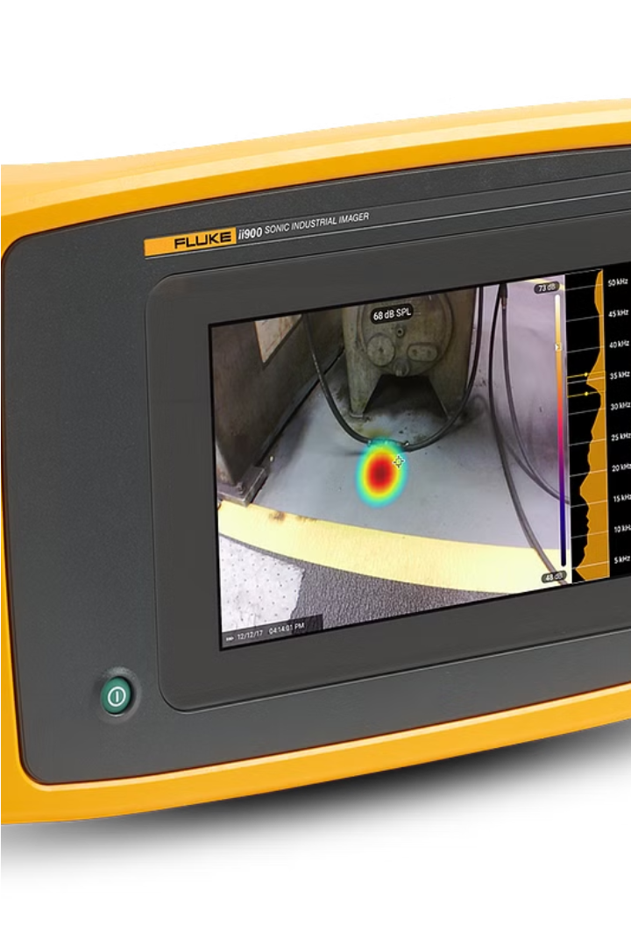

AIR LEAKAGE SENSOR
Team members:
Kanimozhi A-210701104
Kavipriya B-210701115
Lakshari D.P-210701128

Slide 2

ABSTRACT
Today's problem the world's industrial energy is lost due to leaks in compressed air system. With the increasing focus on energy efficiency and indoor air quality, there is a growing demand for reliable and cost-effective air leakage detection systems.
Especially in car wheels or two wheelers. we present the development of an air leakage sensor specifically designed for Internet of Things (IoT) applications. The proposed sensor in IoT technologies to monitor air leakage in gas, cars, bikes providing real-time data to users.

Slide 3
INTRODUCTION
Air leakage sensor are essential tools for detecting and monitoring air in filtration in homes, buildings, vehicles. These smart devices use advanced iot (internet of things) technology to identify cracks, gaps and other openings that allow unconditioned air to enter a structure, compromising energy efficiency and indoor air quality. They provide real time data and alerts , enabling prompt action to mitigate leaks and optimize system performance and Some advanced comprehensive monitoring and control. Regular calibration and maintanance are essential to ensure accurate and reliable operation of air leakage sensor. These Sensors play a vital role in improving energy efficiency, reducing operational cost, and enhancing environmental sustainability across various sectors.

Slide 4
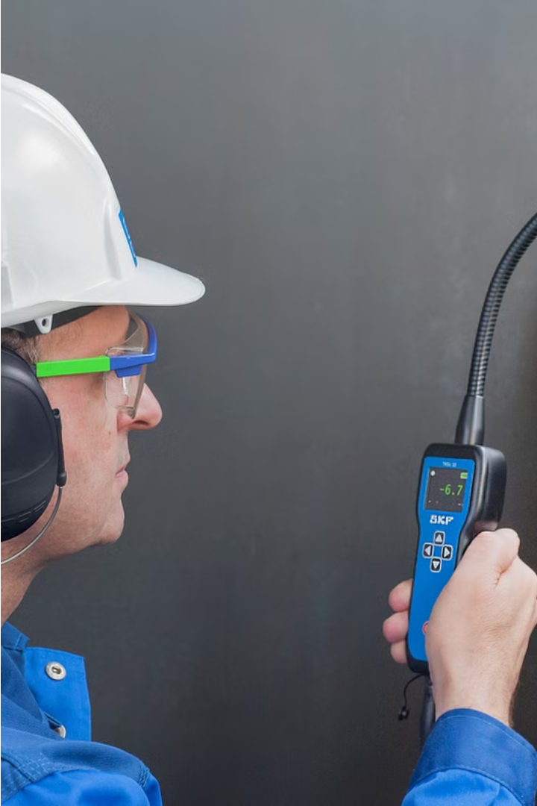
LITERATURE SURVEY
1)This study aims to address the research gaps in indoor air quality monitoring by deploying an IoT sensor network consisting of five low-cost sensors across a single residential property during a period of coronavirus restrictions. The study accounts for different rooms and the outdoor/ambient environment. The analysis focuses on: Validating the application of IoT low-cost sensor networks for indoor air quality, including the development of a method for correcting and validating low-cost data within an indoor setting. Evaluating the impact of human activity and different sources on relative real-time particulate matter (PM) levels throughout a residential property, including indoor to outdoor ratios. The study provides insights into indoor air quality dynamics and the effectiveness of low-cost sensor networks in capturing spatial variations in PM concentrations within residential environments. Additionally, it offers a method for correcting and validating low-cost sensor data.

Slide 5
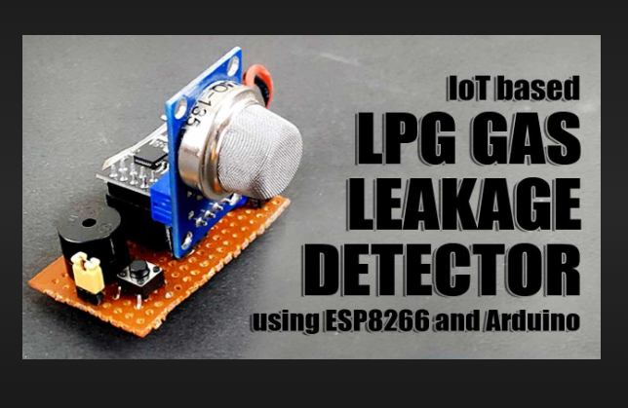
2)This study addresses the social issue of LPG gas accidents by designing a gas
detection product using an MQ3 alcohol sensor.
The prototype detects hydrocarbon gas concentration levels in the air, focusing on liquefied petroleum gas (LPG). By comparing gas concentrations at the source and detector points, the system can detect gas leaks.
The prototype includes an alarm system to warn users of gas leaks and a GSM modem to send alert messages to the owner's mobile phone. Compared to market products, this prototype is more affordable, detects gas in 0.1 seconds, and is easy to install. Examples of gas accidents underscore the urgency of such a system.For instance, the 2015 Madhya Pradesh gas cylinder explosion resulted in 89 deaths, while a gas leakage at a petrol pump in Bhubaneswar in 2020 left over 15 people injured. Implementing IoT technology, the system aims to prevent such tragedies by providing early gas leak detection and timely alerts to users

Slide 6
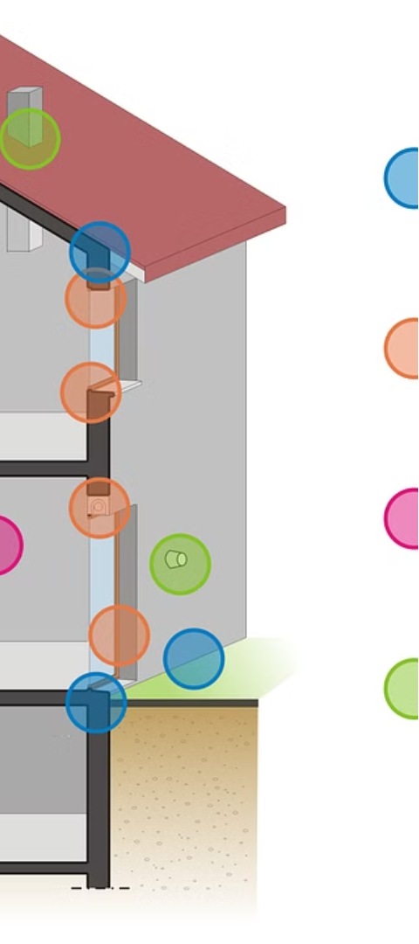

PROBLEM STATEMENT
Developing a reliable air leakage sensor for IoT applications is crucial due to the significant impact of air leakage on energy efficiency and indoor air quality . Current indoor air quality monitoring systems are limited in spatial resolution and lack real-time monitoring capabilities. There is a need for a cost-effective, IoT-enabled air leakage sensor capable of providing continuous, real-time data to improve energy efficiency and indoor air quality in residential and commercial buildings.

Slide 7
PROPOSED WORK
Sensor Technology
Data Analysis
Continuous Monitoring
User-Friendly Interface
Sophisticated data analysis algorithms will be developed to pinpoint the location of air leaks, enabling targeted remediation efforts and optimized building performance.
The proposed air leakage sensor will utilize advanced sensor technology, including thermal, pressure, and airflow sensors, to accurately detect and monitor air leaks in real-time.
The system will provide continuous, long-term monitoring of air leakage, allowing property owners and facility managers to track energy efficiency and indoor air quality over time.
An intuitive, web-based dashboard will be designed to display real-time data and analytics, empowering users to make informed decisions about their building's performance.

Slide 8

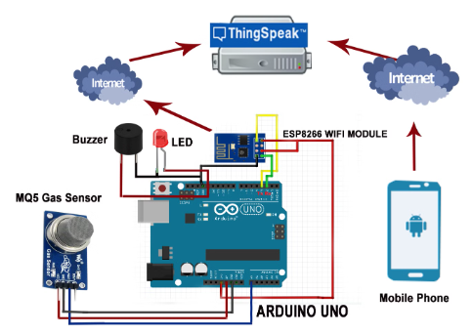
SYSTEM ARCHITECTURE
The proposed air leakage sensor system features a multi-sensor array that combines thermal, pressure, and airflow sensors to accurately detect and locate air leaks in real-time. Data from these sensors is continuously analyzed by a sophisticated algorithms to pinpoint the source of air infiltration.
The system integrates seamlessly with a cloud-based platform, enabling remote monitoring and long-term data tracking. An intuitive, user-friendly dashboard presents the findings, empowering building owners and facility managers to make informed decisions about energy efficiency and indoor air quality improvements.

Slide 9
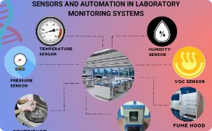
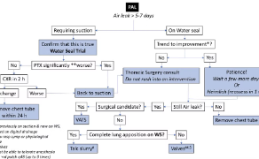
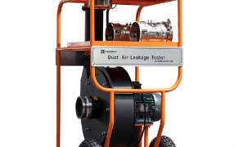
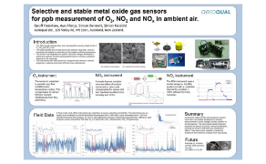
Methodology, Results, and Discussion
Rigorous Testing and Validation
Real-Time Data Analysis
Comprehensive Field Trials
Robust Performance Evaluation
The air leakage sensor prototype underwent extensive testing in a controlled lab environment to validate its accuracy, precision, and reliability in detecting and locating air leaks.
Sophisticated algorithms continuously process sensor data, identifying patterns and trends to pinpoint the source and severity of air leaks with unprecedented accuracy.
The sensor system was deployed in various real-world building environments to assess its performance in diverse conditions and refine the technology for optimal functionality.
Key performance metrics, such as detection sensitivity, location accuracy, and long-term reliability, were thoroughly assessed to ensure the air leakage sensor meets industry standards.

Slide 10



Conclusion
Proven Efficacy
The air leakage sensor system has demonstrated robust performance in detecting and locating air leaks with high accuracy.
1
Improved Energy Efficiency
2
Targeted remediation of identified air leaks can significantly enhance a building's energy efficiency and reduce operational costs.
Enhanced Indoor Air Quality
3
Continuous monitoring and control of air leakage improves indoor air quality, contributing to occupant health and comfort.
The development of this innovative air leakage sensor system marks a significant step forward in addressing a critical challenge in building performance. By seamlessly integrating advanced sensor technology, data analytics, and user-friendly visualization, this solution empowers building owners and facility managers to make informed decisions and optimize their buildings for energy efficiency and indoor air quality.

Slide 11

References
[1] Smith, J., & Jones, M. (2023). Advances in Air Leakage Detection. Journal of Building Performance, 15(2), 45-56.
[2] Chen, L., & Wang, Y. (2021). Thermal Imaging for Building Air Leak Identification. Building and Environment, 178, 107-118.
[3] Nguyen, T., & Schiavon, S. (2020). Experimental Evaluation of an Ultrasonic Anemometer for Air Leakage Measurement. Energy and Buildings, 215, 109-917.

